Slide 1
IPR Term 1 Week 6
Normal distribution
& Z-scores
Dr Hayley Dewe
(Assistant Professor)

Slide 2
Announcements
Practical 3 is underway – you need this data for your Formative Assessment
Formative Assessment
Due 3rd December 2025
UPDATED information is now on ultra including a template, and marking rubric (exact criteria that we’re looking for)
Summative Assessment
Class test (in person) 11th December
Compulsory, bring a charged laptop (need Ultra access)

Slide 3
Learning Outcomes
Describe different types of data distributions (e.g. normal vs skewed)
Explain the characteristics of a normal distribution
Explain why the distribution and normality are important for statistical inference
Understand what Z-scores are, how they’re calculated, and how to interpret them
Relate Z-scores to probability, the normal curve and predicting data

Slide 4
Lesson Outline
Distribution of Data
Z-scores & the Normal Distribution
Probability and Predicting Data
Non-Normal Distributions
Calculate and interpret Z-scores (Online Content)

Slide 5
RECAP: Descriptives
Descriptive statistics
Definition: Summarises and organizes data to describe what is observed (i.e. describing your sample)
Purpose: Provides a snapshot of the dataset
Common Measures:
- Central tendency (mean, median, mode)
- Variability (range, standard deviation)
- Graphs (histograms, bar charts, pie charts)

Slide 6
RECAP: Why Descriptives matter?
Descriptive measures of central tendency are important to summarise the data (typical value / centre of the data) and measures of dispersion are important to show the spread / variability in the data points (distance from the mean)
Last week - discussed why it’s so important to visualise your data!
And to use the correct descriptives and type of graph to display the data most appropriately and accurately

Slide 7

Distribution of Data

Slide 8
Distribution of Data
Visual representation of the data
Distribution of data: overall shape and pattern of the data
How the data looks overall, how data are arranged or spread across values
Looks at:
Shape: overall pattern, tells us where most data points cluster
Symmetry: if the left and right sides mirror each other around the centre
Tails: thin ends of the distribution curve (extreme values).
Long tails = more outliers
Heavy tails = higher chance of extreme values
Influence testing = rare events fall in the tails

Slide 9
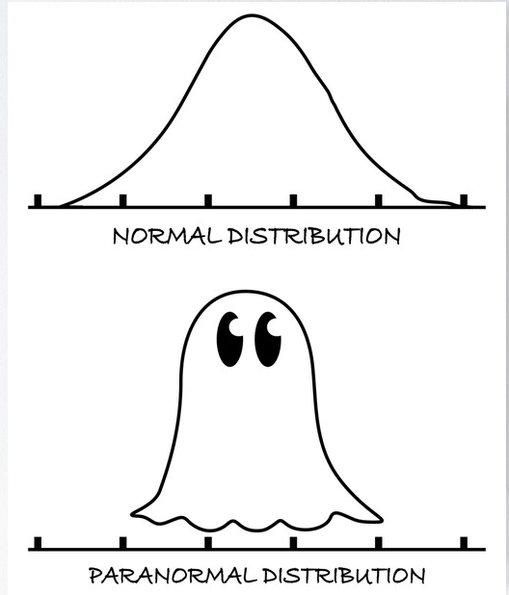
Distribution of Data
Common Distributions
Normal (bell-shaped, symmetric)
Skewed (tail longer on one side)
Bimodal (two high points)
Uniform (flat, values spread evenly)

Slide 10
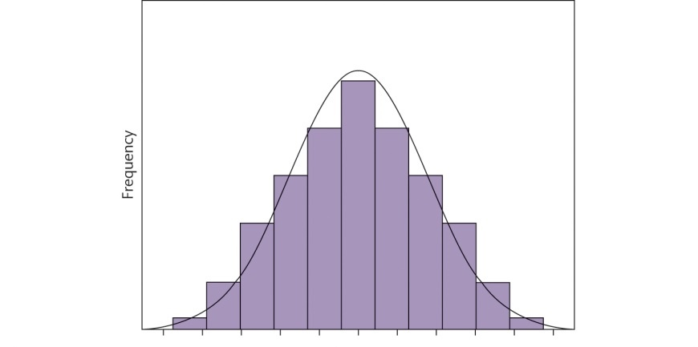
Normal Distribution
(also known as the bell curve or Gaussian distribution)
Bell-shaped
Cluster around the centre (one peak)
Symmetric on both sides of the peak (the mean)
Tails = fewer values as you move away from the centre (extremes)
A perfectly normal distribution:
Mean = Median = Mode
Most common: many variables follow this typical* pattern
*these are ‘idealised’ or ‘in-theory’ examples – real data look similar, but not exact!

Slide 11
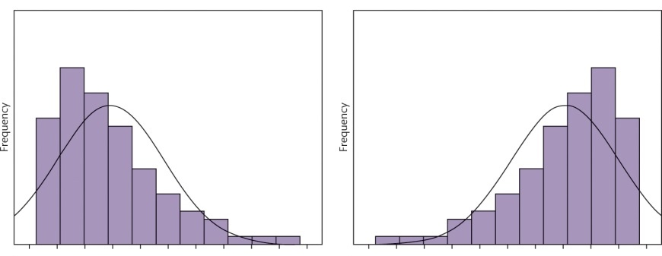
Skewed Distribution
(or the asymmetric distribution)
The asymmetrical nature of a distribution
Tail stretched more on one side
Left and right sides are not mirror images
One peak, most values cluster on one side of the peak
Positively skewed: right-skewed, tail is longer on the right of the peak, most data is on the left
Negatively skewed: left-skewed, tail is longer on the left of the peak, most data on the right
Positive skew
Negative skew

Slide 12
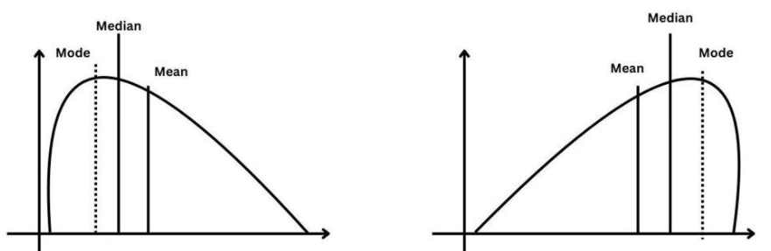
Skewed Distribution
Positively skewed: data is concentrated towards higher values (most data on the left)
Negatively skewed: data is concentrated towards lower values (most data on the right)
Positive skew
Negative skew
Values are more stretched to one side of the Mean (Mode and Median fall at different points)

Slide 13
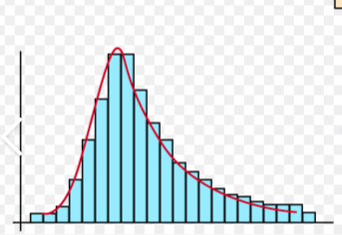
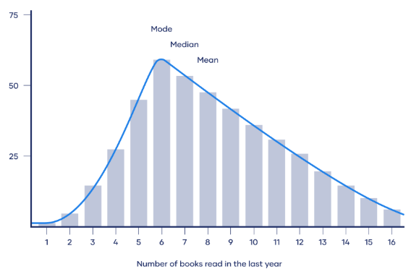
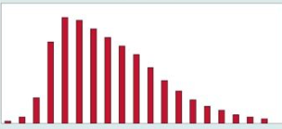
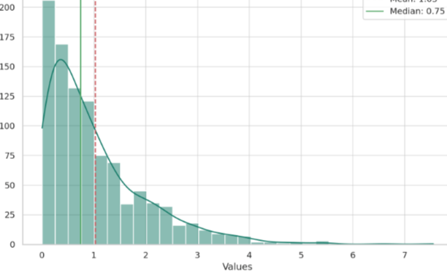
Skewed Distribution

Slide 14
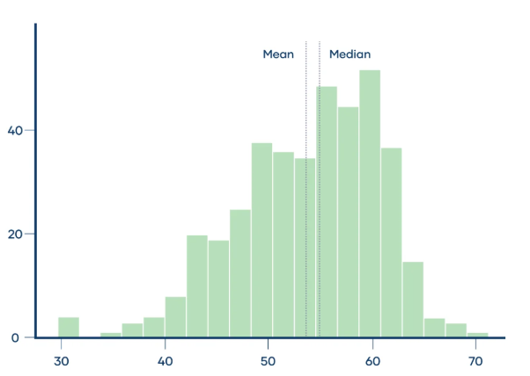
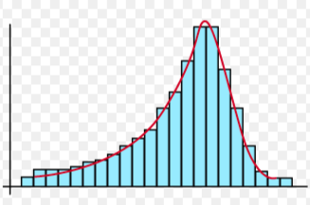
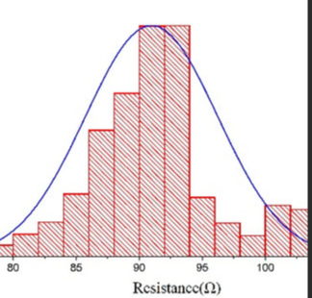
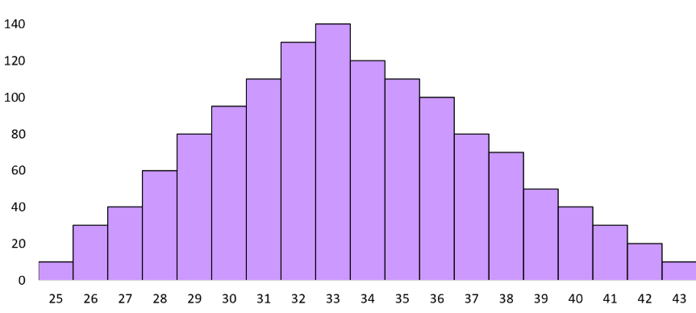
Skewed Distribution

Slide 15
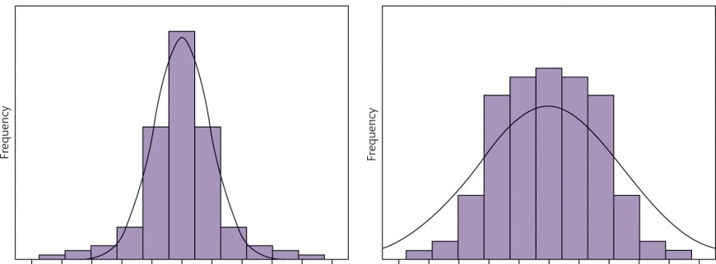
Kurtosis
The shape aka the ‘tailedness’ (i.e., tails and outliers) of a distribution
(e.g. heavier or lighter tails)
You can also look at how much the data ‘peak’ in comparison to a normal distribution
High Kurtosis (Leptokurtic)
Normal Kurtosis (Mesokurtic)
Low Kurtosis (Platykurtic)
> 3, sharp peak, heavier tails, more extreme outliers
Peak isn’t too sharp; tails are average normal thickness.
< 3 = flatter peak, fewer outliers and lighter tails.
Raw Kurtosis > 3 (or > 0)
Raw Kurtosis = 3 (or 0)
Raw Kurtosis < 3 (or < 0)
Excess Kurtosis often reported rather than Raw = difference between the kurtosis of your distribution and the kurtosis of a normal distribution (3 – 3 = 0).

Slide 16
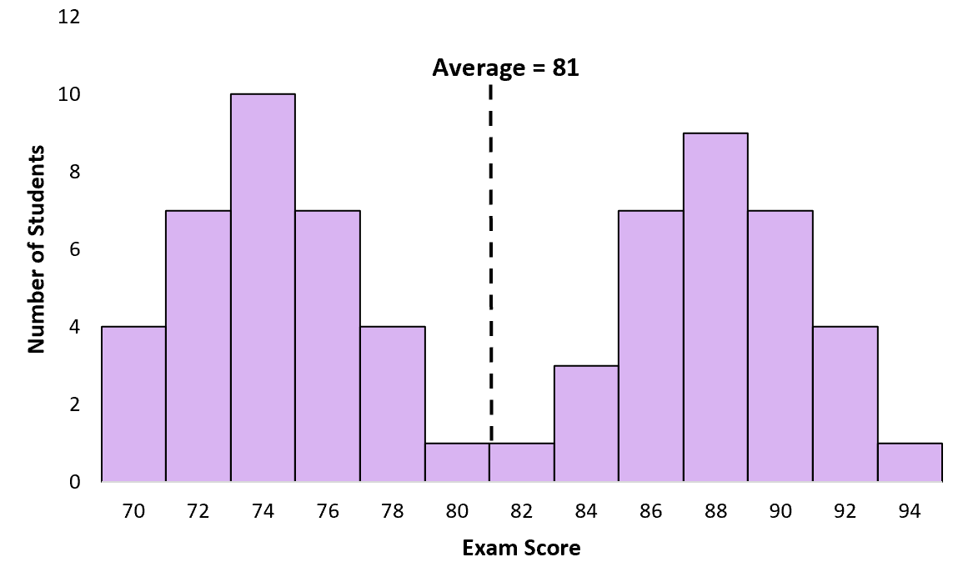
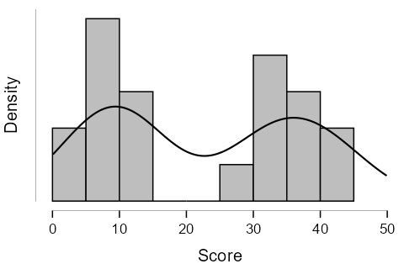
Bimodal Distribution
(also known as the double-peak distribution)
Two clear peaks
Or two clusters / dominant groups
Typically occurs when data come from two different groups
Or indicate sub-populations in the data
Requires careful interpretation e.g., average = 81 in top figure doesn’t accurately reflect the data

Slide 17
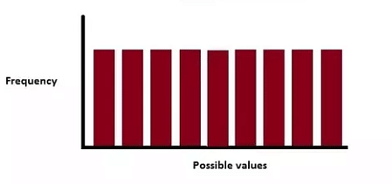
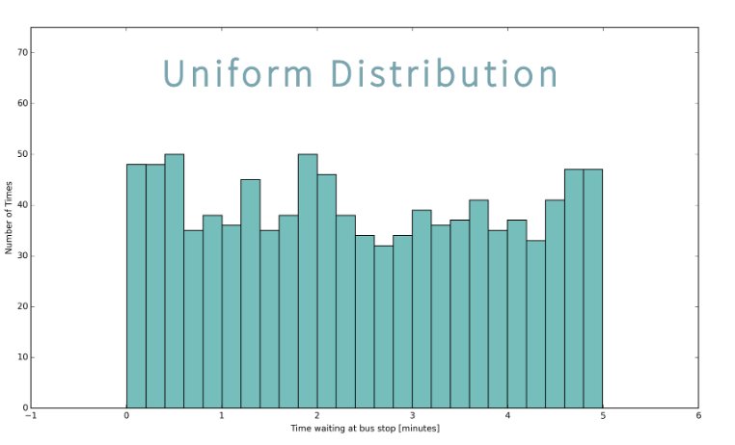

Uniform Distribution
(also known as the rectangular distribution)
Flat shape
No peak, more rectangle shape
All values equally or relatively likely to occur with similar frequency
Values are spread evenly across a fixed range
e.g., 1-6, for a roll of a fair die or random time of day (if every second in 24 hours is equally likely)
This second figure is more like real data. Where it often looks roughly uniform – rather than perfectly flat

Slide 18
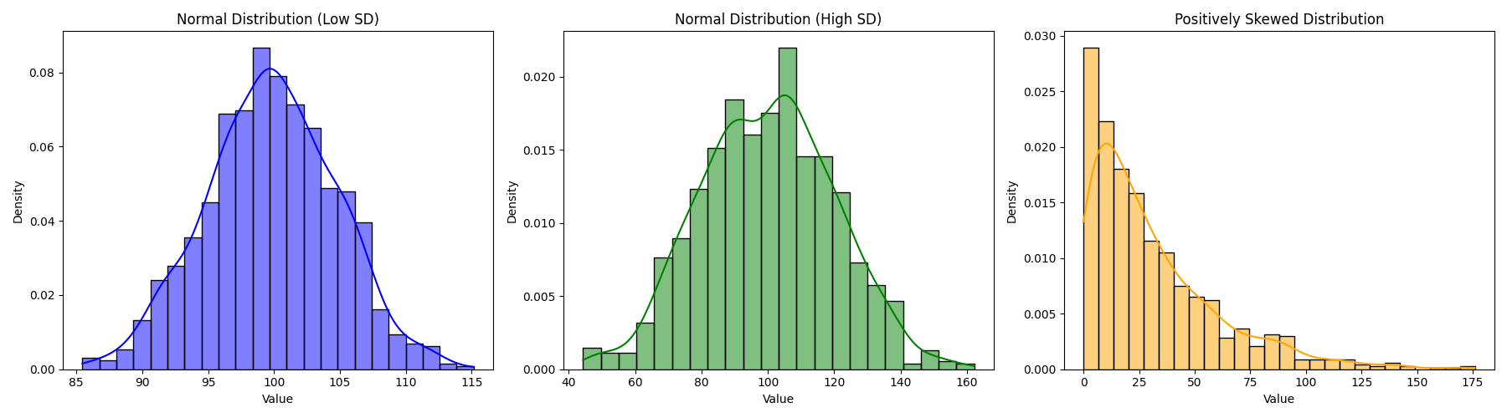
Distribution of Data
Distribution of data answers “what does the data look like overall?”
Different to measures of dispersion (variability) which answers, “how wide or narrow is that distribution?” i.e., the width / spread of the data.
They are distinct e.g.; two datasets can have similar distributions but different variability (or vice versa)

Slide 19
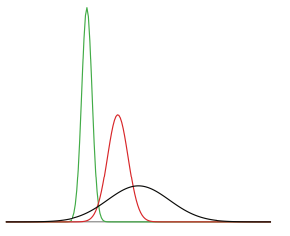
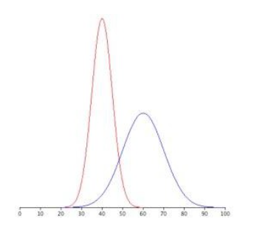
Normal Distributions
All figures here show normal distributions
(different mean and SD)
SD = 5
Remember: variance measures the spread of the data / distribution
High or low mean = determines the centre position (shifts position left or right along x-axis)
Small SD = data is clustered around the mean; curve becomes narrower and taller
Large SD = data is more spread out; curve becomes wider and flatter
SD = 10

Slide 20
Bringing it all together
Distribution Type | KEY CHARACTERISTICS | Example | EXAMPLE EXPLAINED​
Normal​ | Bell-shaped, one peak, symmetric | IQ (or height) | Most people cluster around the average IQ, with fewer very high or very low scores
Skewed Positive​ | Stretched tail to the right | Income (or reaction times) | Most people earn a modest amount, but a few earn extremely high incomes
Skewed Negative​ | Stretched tail to the left | Retirement Age (or exam completion times) | Most people retire around 65 years – but some retire very early, creating a long tail on the left
Bimodal​ | Two peaks | Scores on a mixed-ability class | If a class has two distinct groups (e.g., revised or didn’t revise) scores cluster around two different points
Uniform | Flat | Rolling a fair die (or randomly picking a day of the week) | Each outcome (1-6) is equally likely, so the distribution is flat across the 1 - 6 range

Slide 21
Why Distribution matters
Understanding the shape of a distribution – e.g., whether the data are normally distributed (or skewed) is crucial data for inference:
Inferential statistics
Definition: Uses sample data to make predictions, decisions or generalisations about a population (i.e., moving beyond describing your sample)
Purpose: Tests hypotheses, identify patterns or infer about the data.

Slide 22
Why Distribution matters
The shape of a distribution is important for inference:
For accurate predictions and hypothesis testing
Many inferential tests assume data have a normal distribution (known as parametric tests)
If the distribution is non-normal (e.g. skewed) you may need to:
Transform the data
Use a non-parametric test
Many inferential tests assume the variance (or dispersion) is similar across groups (known as homogeneity of variance)
If the variance is greatly different between groups:
Your tests may not be valid
You may have to use adjusted / corrected tests or non-parametric tests
Normal distribution acts as a foundation: to understand how scores relate to one another within a distribution (e.g. a sample) and across distributions – to predict and standardise scores, so we can compare different populations, or different measures etc.

Slide 23
Why Distribution matters
Having a normal distribution is central to hypothesis testing
i.e., it’s called an ‘assumption of normality’
There are other assumptions you will learn about soon – that all must be met* (achieved) in order for you to run a specific test
*However, as you will come to learn – some of the assumptions (including the one of normality) are more flexible / tolerant than others

Slide 24
2. Z-scores & the Normal Distribution

Slide 25
Standardising Scores
We know measures of central tendency (e.g. mean) and dispersion (e.g. standard deviation) are important.
SD = on average how far are values from the mean - it gives us a sense of variability (spread) within one dataset.
But it doesn’t let you compare against different datasets (or scales)
Or if two datasets have different means or SDs – then comparing data values directly can be misleading.
So, we standardise our data into Z-scores…

Slide 26
Standardising Scores
Z-scores use the Mean and SD
Allow comparisons within datasets – the sample distribution (i.e., your sample) to help interpret values or detect unusual values
OR they allow comparisons across different datasets (e.g. different groups or scales)
OR to a theoretical population distribution (e.g., the normal distribution)
Z-scores are calculated assuming a normal distribution

Slide 27
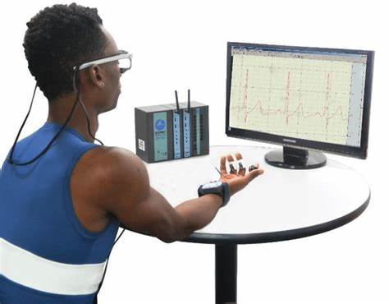
My (Cog Neuro) Research Example
Measuring anxiety to threat stimuli
Test 2 people, taking ‘threat’ response as their highest score
It might not be the most accurate reflection of their anxiety/threat response
I must compare their ‘peak’ threat response to their individual average ‘anxiety’ levels (Z-scores)
Accounts for individual differences and allows comparisons across participants to be made

Slide 28
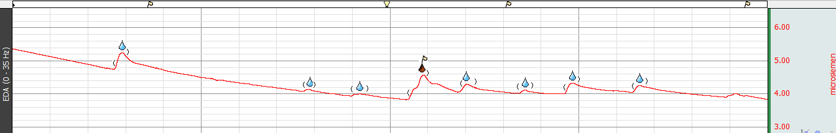
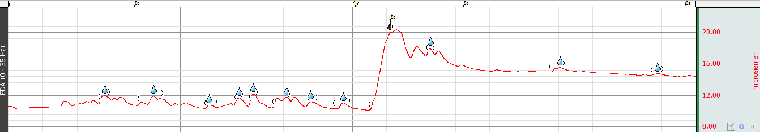
My (Cog Neuro) Research Example
Two participants have a threat score of 2 (microsiemens)
Participant A
Comparing an increase of 2 (threat) against and average background of 4 microsiemens (ranges 3 to 5)
Participant B
Comparing an increase of 2 (threat) against and average background of 14 microsiemens (range 8 to 20)

Slide 29
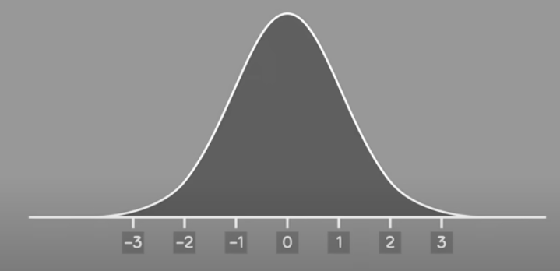
Normal Distribution
How does a normal distribution help predict where most scores will fall (i.e., estimating population parameters)?
We know they are:
Bell-shaped
Cluster around the centre
Symmetric
Mean = Median = Mode
But also
The normal curve represents probabilities
Area under the curve = 1 (or 100%)
Centred at 0 (increments of 1)
The tails are rare events (extreme values)
On the standard normal distribution, the x-axis shows Z-scores
Z-scores are standardised values showing how many SDs a data point is from the mean
μ = 0, σ = 1
When talking about population parameters use:
Population mean = μ
Population standard deviation = σ

Slide 30
What are Z-scores?
Z-scores are calculated by the mean/centre of the distribution (the location) and the width/spread of the data.
Tells us exactly where in the standard normal distribution a value is located - how far away the score is from the mean
Z-scores tell you the following about a raw score:
Magnitude value – size in standardised units of the difference / distance from the mean/centre
Larger the Z-score = more rare (smaller probability)
Generally, fall between -3 and 3
Location – which half of the distribution is the raw score sitting. Denoted by a sign (positive or negative)
Positive Z-score = above the mean, to the right
Negative Z-score = below the mean, to the left
Also sometimes used to report the actual results of analysis tests (known as Z statistic) – more in future weeks

Slide 31
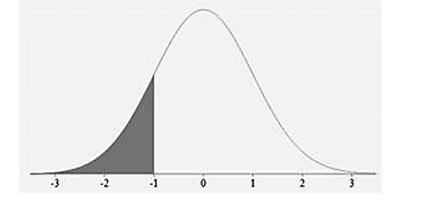
What are Z-scores?
Z-score = -1
Tells us that a score is 1 standard deviation away from the mean
The sign is negative – so it’s below the mean (direction is to the left)

Slide 32
Calculating Z-scores
We can calculate them ourselves with a formula:
X - μ
Population Z-score
X = Raw data / observed score
μ = population mean
σ = population standard deviation
Z =
σ
X - x̅
Sample Z-score
X = Raw data / observed score
μ = population mean
σ = population standard deviation
Z =
S

Slide 33


Calculating Z-scores - Example
IQ scores
I’m measuring average IQ scores among a group of celebrities
Ryan Reynolds has an IQ of 130
The average IQ score for my group is 100. The standard deviation is 15.
What is Ryan’s Z-score?
X = 130
x̅ = 100
S = 15
X - x̅
Z =
S
130 - 100
= 2
Z =
15
What does this score mean?

Slide 34
3. Probability and predicting data

Slide 35
What does a Z-score value mean?
You’ve calculated your z-score from a raw data point, great!
But what does it actually mean / when would you use it?
You can interpret the data in terms of probability
e.g. what is the proportion of values that fall below my z-score in a standard normal distribution (e.g., how unique / typical is it?)
Why is it useful?
To know what percentage of scores are below yours
Gives you a probability that a value falls between two points
For hypothesis testing – how extreme is this result?

Slide 36
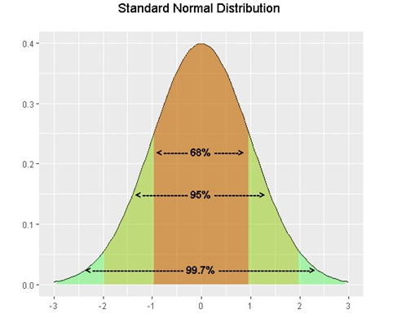
Z-scores & the Distribution
Applying standardisation and Z-scores
To do this, we can use the ‘Empirical Rule’ (or the ‘68-95-99’ rule)
68% of the data falls within 1 standard deviation of the mean
95% of the data falls within 2 standard deviations of the mean
99.7% falls within 3 standard deviations of the mean
The further out you go from the mean, the less typical the score

Slide 37
Predicting Data - Example
Mean = 50
SD = 10 (remember SD is in units – so the unit is in 10s)
68% of the data falls within 1 standard deviation of the mean
68% of the data falls between 40 - 60 (Mean = 50, SD = + 10)
95% of the data falls within 2 standard deviations of the mean
95% of the data falls between 30 - 70 (Mean = 50, SD = + 20)
99.7% falls within 3 standard deviations of the mean
95% of the data falls between 20 - 80 (Mean = 50, SD = + 30)

Slide 38
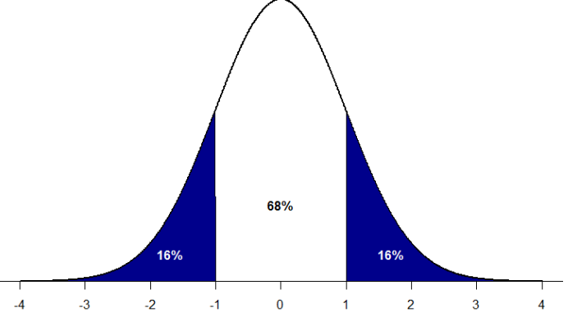
Z-scores & the Distribution
Any area under the curve is defined by a single Z-score or pair (range of Z-scores)
Because the area under the curve = 1.0 (or 100)
Chances of selecting a Z-score from all possible Z-scores outside of Z = -1 and Z = +1 are equal to 32% (16% each side, because its symmetrical)
Or, there’s a 68% chance it’ll fall between -1 and +1

Slide 39
Z-scores & the Distribution
Or another way to think of it is like this:
+ 1 SD = Common
Close to the Mean
“Common”

Slide 40
Z-scores & the Distribution
Or another way to think of it is like this:
+ 2 SD = Still common overall, but includes some unusual values
“Unusual”

Slide 41
Z-scores & the Distribution
Or another way to think of it is like this:
+ 3 SD = includes almost everything (99.7%). Values beyond + 2 SD are rare.
Beyond + 3 SD (the remaining 0.3%) are extremely rare – more on that in future weeks
“Rare”

Slide 42
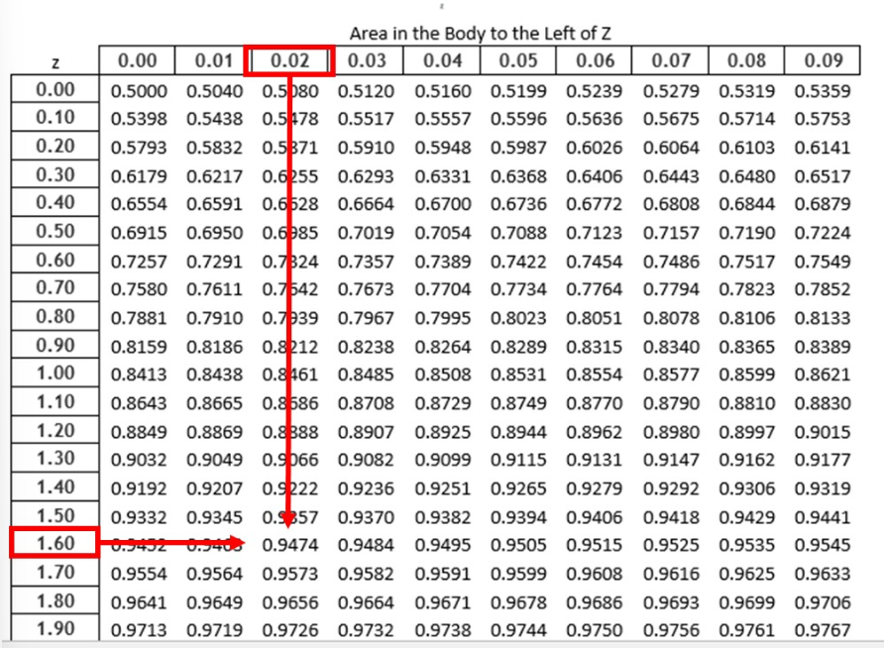
What does a Z-score value mean?
How do you find these Z-score probabilities?
Manually using Z-tables (e.g., Z TABLE) or there’s online databases/calculators
But don’t worry! Our friend JASP does it for us!

Slide 43

Summary: Why are Z-scores important?
Gives the relative location of the person’s score within its distribution
See if a score is unusual or typical, even if two datasets are very different
Make meaningful comparisons –across datasets (samples, groups, measures etc.)
Quantifies the difference between the raw data and what is expected
Transform non-normal distribution to a normal distribution – convert scores into z-scores
Detect outliers / extreme values, (e.g. z-scores <-3 or >+3

Slide 44
4. Non-normal distributions

Slide 45
What if you have Non-Normal Data?
You can technically still calculate Z-scores (the formula works for any dataset)
But interpreting them against a normal curve isn’t valid - unless the data are approximately normal.
If data are completely ‘non-normal’…
Transform the data to get approximate normality
Instead, use specific analysis tests (non-parametric tests)
Use percentile ranks instead of Z-scores for interpretation
Remember: large samples often mean the distribution tends to be normal, even if the raw data aren’t.

Slide 46
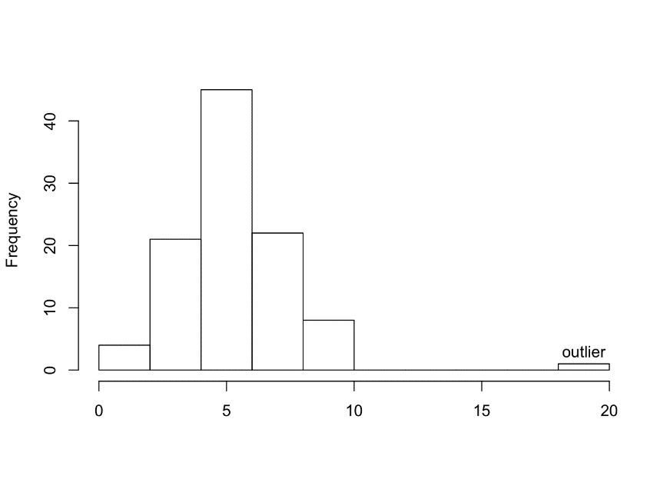
Why could Data be Non-Normal?
As I mentioned, it won’t always look pretty / perfect!
Outliers: data point that differs significantly from other observations
Keep in or remove?
Either! But it must be justified theoretically and/or statistically
Remove if it’s due to measurement error or a data entry mistake
Or if disproportionately affects results (depends on research area/criteria)
But if it’s a genuine observation – its worth keeping in. Meaningful variability?
Key: be transparent

Slide 47
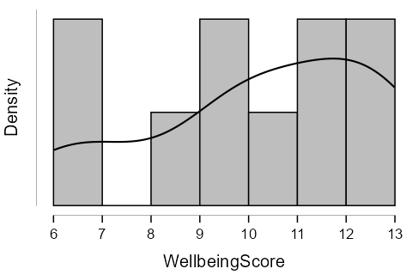
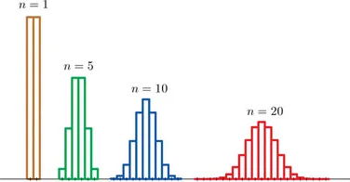
Why could Data be Non-Normal?
Outliers: data point that differs significantly from other observations
Insufficient data: sample size too small
But…the central limit theorem:
The sampling distribution of the mean approaches a normal distribution, as the sample size increase

Slide 48
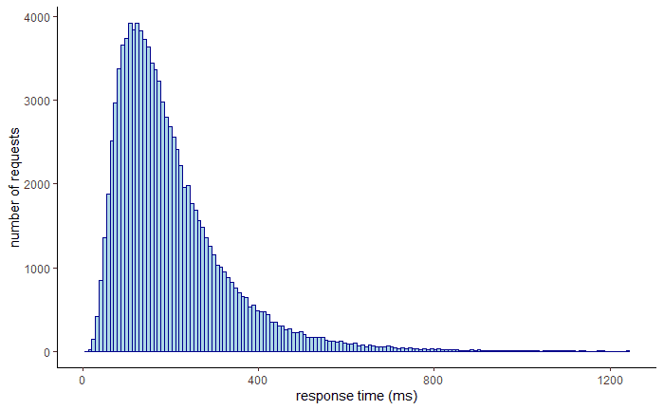
Why could Data be Non-Normal?
Outliers: data point that differs significantly from other observations
Insufficient data: sample size too small
Multiple distributions: bimodal (or multimodal)
Measurement issues
Or just some silly mistake!

Slide 49
Summary / Take-home
Normal distributions are bell-shaped and symmetric, forming the basis for many statistical tests.
Z-scores standardise data by showing how many standard deviations a value is from the mean
Z-scores allow us to compare scores across or within datasets and identify outliers or extreme/unusual values.
Most Z-scores fall within ±1 SD and ±3 SD, beyond ±3 SD is rare. Further from the mean = less typical the score
Understanding these concepts is essential for interpreting probabilities and preparing for hypothesis testing.

Slide 50

Online Content!
Don’t forget to do the Online content – calculate and interpret Z-scores
Next week: Formative lab report writing! (it’s a bit lighter, have a break from theory)

